Slide 1
Dijeljenje racionalnih brojeva

Slide 2
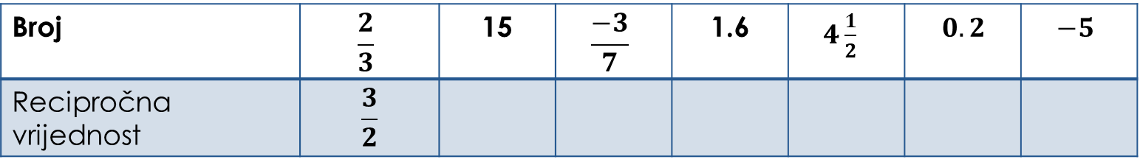
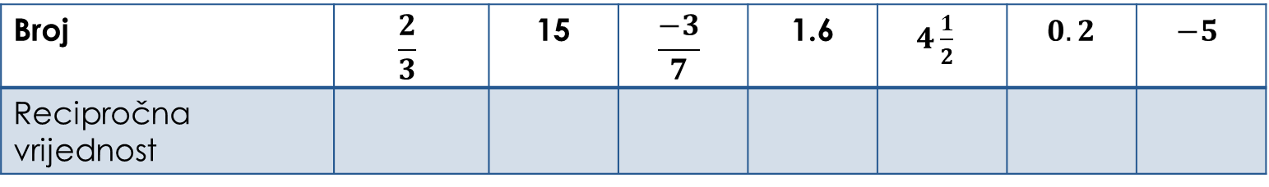
Uvod
Što su recipročni brojevi?
Zadatak: Dopuni tablicu.
Broj | $$\frac{2}{3}$$ | 15 | $$\frac{−3}{7}$$ | 1.6 | $4\frac{1}{2}$ | $0.2$ | $$−5$$
Recipročna vrijednost
Broj | $$\frac{2}{3}$$ | 15 | $$\frac{−3}{7}$$ | 1.6 | $4\frac{1}{2}$ | $0.2$ | $$−5$$
Recipročna vrijednost | $$\frac{3}{2}$$

Slide 3
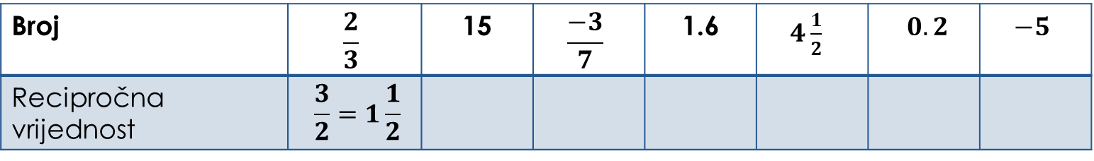

Uvod
Što su recipročni brojevi?
Zadatak: Dopuni tablicu.
Broj | $$\frac{2}{3}$$ | 15 | $$\frac{−3}{7}$$ | 1.6 | $4\frac{1}{2}$ | $0.2$ | $$−5$$
Recipročna vrijednost | $$\frac{3}{2}=1\frac{1}{2}$$
Broj | $$\frac{2}{3}$$ | 15 | $$\frac{−3}{7}$$ | 1.6 | $4\frac{1}{2}$ | $0.2$ | $$−5$$
Recipročna vrijednost | $$\frac{3}{2}$$

Slide 4
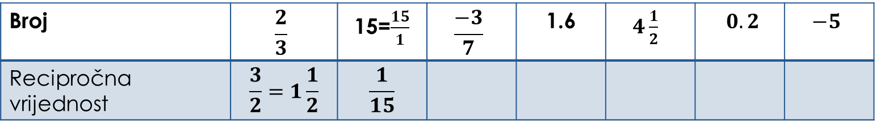
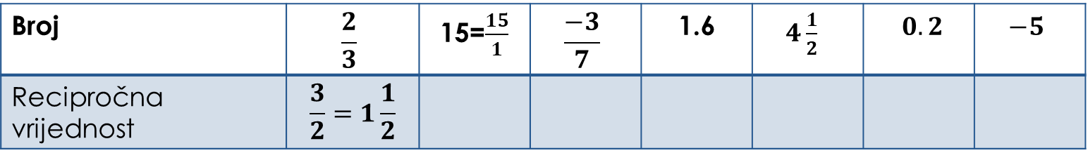
Uvod
Što su recipročni brojevi?
Zadatak: Dopuni tablicu.
Broj | $$\frac{2}{3}$$ | 15=$\frac{15}{1}$ | $$\frac{−3}{7}$$ | 1.6 | $4\frac{1}{2}$ | $0.2$ | $$−5$$
Recipročna vrijednost | $$\frac{3}{2}=1\frac{1}{2}$$
Broj | $$\frac{2}{3}$$ | 15=$\frac{15}{1}$ | $$\frac{−3}{7}$$ | 1.6 | $4\frac{1}{2}$ | $0.2$ | $$−5$$
Recipročna vrijednost | $$\frac{3}{2}=1\frac{1}{2}$$ | $$\frac{1}{15}$$

Slide 5
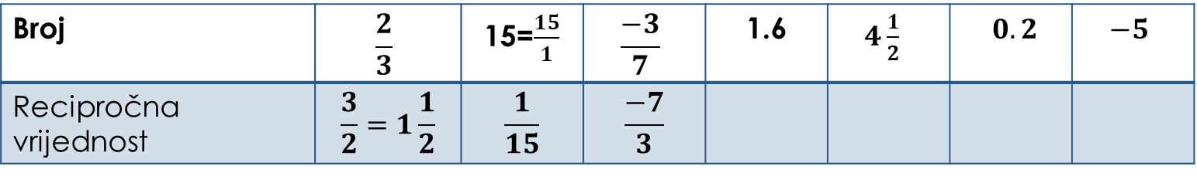
Uvod
Što su recipročni brojevi?
Zadatak: Dopuni tablicu.
Broj | $$\frac{2}{3}$$ | 15=$\frac{15}{1}$ | $$\frac{−3}{7}$$ | 1.6 | $4\frac{1}{2}$ | $0.2$ | $$−5$$
Recipročna vrijednost | $$\frac{3}{2}=1\frac{1}{2}$$ | $$\frac{1}{15}$$ | $$\frac{−7}{3}$$
Broj | $$\frac{2}{3}$$ | 15=$\frac{15}{1}$ | $$\frac{−3}{7}$$ | 1.6 | $4\frac{1}{2}$ | $0.2$ | $$−5$$
Recipročna vrijednost | $$\frac{3}{2}=1\frac{1}{2}$$ | $$\frac{1}{15}$$

Slide 6
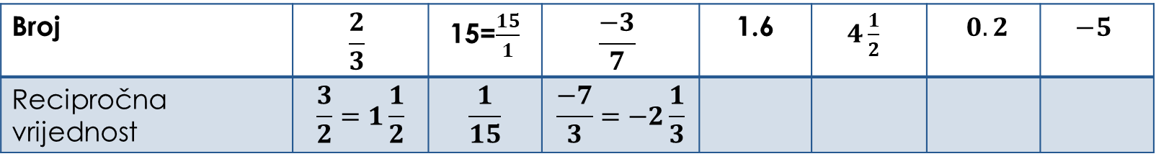
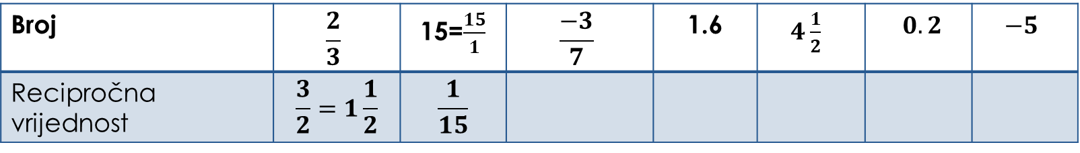
Uvod
Što su recipročni brojevi?
Zadatak: Dopuni tablicu.
Broj | $$\frac{2}{3}$$ | 15=$\frac{15}{1}$ | $$\frac{−3}{7}$$ | 1.6 | $4\frac{1}{2}$ | $0.2$ | $$−5$$
Recipročna vrijednost | $$\frac{3}{2}=1\frac{1}{2}$$ | $$\frac{1}{15}$$ | $$\frac{−7}{3}=−2\frac{1}{3}$$
Broj | $$\frac{2}{3}$$ | 15=$\frac{15}{1}$ | $$\frac{−3}{7}$$ | 1.6 | $4\frac{1}{2}$ | $0.2$ | $$−5$$
Recipročna vrijednost | $$\frac{3}{2}=1\frac{1}{2}$$ | $$\frac{1}{15}$$

Slide 7
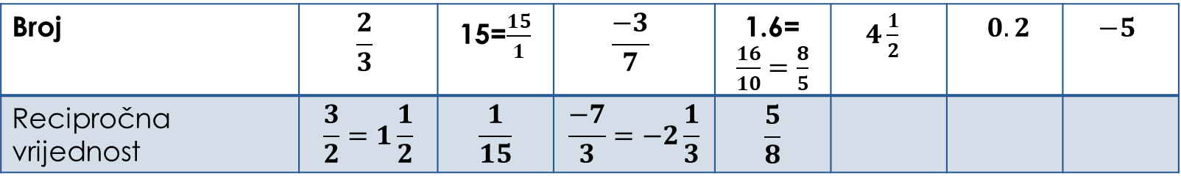
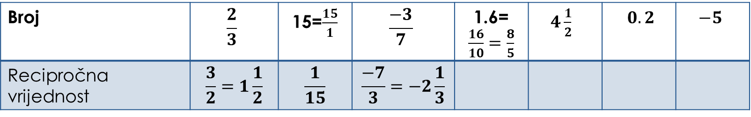
Uvod
Što su recipročni brojevi?
Zadatak: Dopuni tablicu.
Broj | $$\frac{2}{3}$$ | 15=$\frac{15}{1}$ | $$\frac{−3}{7}$$ | 1.6=$\frac{16}{10}=\frac{8}{5}$ | $4\frac{1}{2}$ | $0.2$ | $$−5$$
Recipročna vrijednost | $$\frac{3}{2}=1\frac{1}{2}$$ | $$\frac{1}{15}$$ | $$\frac{−7}{3}=−2\frac{1}{3}$$
Broj | $$\frac{2}{3}$$ | 15=$\frac{15}{1}$ | $$\frac{−3}{7}$$ | 1.6=$\frac{16}{10}=\frac{8}{5}$ | $4\frac{1}{2}$ | $0.2$ | $$−5$$
Recipročna vrijednost | $$\frac{3}{2}=1\frac{1}{2}$$ | $$\frac{1}{15}$$ | $$\frac{−7}{3}=−2\frac{1}{3}$$ | $$\frac{5}{8}$$

Slide 8
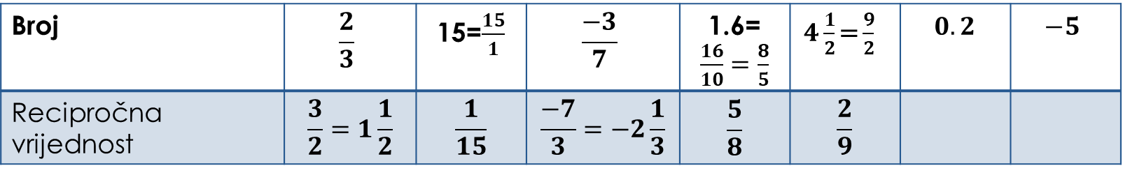
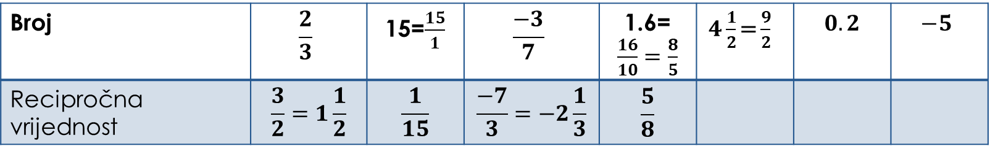
Uvod
Što su recipročni brojevi?
Zadatak: Dopuni tablicu.
Broj | $$\frac{2}{3}$$ | 15=$\frac{15}{1}$ | $$\frac{−3}{7}$$ | 1.6=$\frac{16}{10}=\frac{8}{5}$ | $4\frac{1}{2}\text{=}\frac{9}{2}$ | $0.2$ | $$−5$$
Recipročna vrijednost | $$\frac{3}{2}=1\frac{1}{2}$$ | $$\frac{1}{15}$$ | $$\frac{−7}{3}=−2\frac{1}{3}$$ | $$\frac{5}{8}$$
Broj | $$\frac{2}{3}$$ | 15=$\frac{15}{1}$ | $$\frac{−3}{7}$$ | 1.6=$\frac{16}{10}=\frac{8}{5}$ | $4\frac{1}{2}\text{=}\frac{9}{2}$ | $$0.2$$ | $$−5$$
Recipročna vrijednost | $$\frac{3}{2}=1\frac{1}{2}$$ | $$\frac{1}{15}$$ | $$\frac{−7}{3}=−2\frac{1}{3}$$ | $$\frac{5}{8}$$ | $$\frac{2}{9}$$

Slide 9
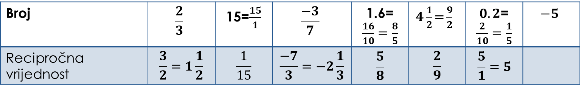
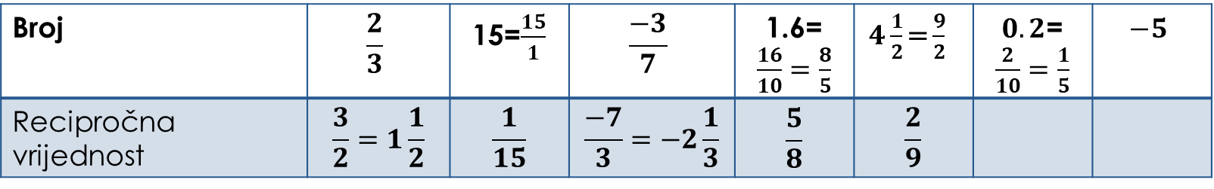
Uvod
Što su recipročni brojevi?
Zadatak: Dopuni tablicu.
Broj | $$\frac{2}{3}$$ | 15=$\frac{15}{1}$ | $$\frac{−3}{7}$$ | 1.6=$\frac{16}{10}=\frac{8}{5}$ | $4\frac{1}{2}\text{=}\frac{9}{2}$ | $0.2$=$\frac{2}{10}=\frac{1}{5}$ | $$−5$$
Recipročna vrijednost | $$\frac{3}{2}=1\frac{1}{2}$$ | $$\frac{1}{15}$$ | $$\frac{−7}{3}=−2\frac{1}{3}$$ | $$\frac{5}{8}$$ | $$\frac{2}{9}$$
Broj | $$\frac{2}{3}$$ | 15=$\frac{15}{1}$ | $$\frac{−3}{7}$$ | 1.6=$\frac{16}{10}=\frac{8}{5}$ | $4\frac{1}{2}\text{=}\frac{9}{2}$ | $0.2$=$\frac{2}{10}=\frac{1}{5}$ | $$−5$$
Recipročna vrijednost | $$\frac{3}{2}=1\frac{1}{2}$$ | $$\frac{1}{15}$$ | $$\frac{−7}{3}=−2\frac{1}{3}$$ | $$\frac{5}{8}$$ | $$\frac{2}{9}$$ | $$\frac{5}{1}=5$$

Slide 10
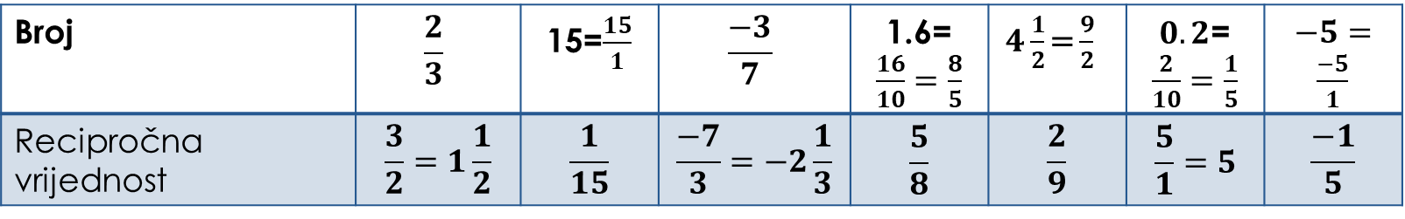
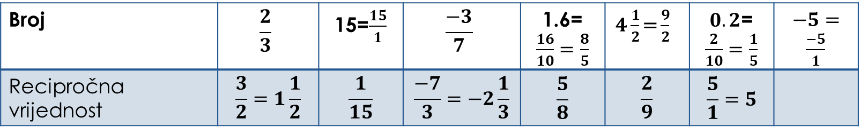
Uvod
Što su recipročni brojevi?
Zadatak: Dopuni tablicu.
Broj | $$\frac{2}{3}$$ | 15=$\frac{15}{1}$ | $$\frac{−3}{7}$$ | 1.6=$\frac{16}{10}=\frac{8}{5}$ | $4\frac{1}{2}\text{=}\frac{9}{2}$ | $0.2$=$\frac{2}{10}=\frac{1}{5}$ | $−5=\frac{−5}{1}$
Recipročna vrijednost | $$\frac{3}{2}=1\frac{1}{2}$$ | $$\frac{1}{15}$$ | $$\frac{−7}{3}=−2\frac{1}{3}$$ | $$\frac{5}{8}$$ | $$\frac{2}{9}$$ | $$\frac{5}{1}=5$$
Broj | $$\frac{2}{3}$$ | 15=$\frac{15}{1}$ | $$\frac{−3}{7}$$ | 1.6=$\frac{16}{10}=\frac{8}{5}$ | $4\frac{1}{2}\text{=}\frac{9}{2}$ | $0.2$=$\frac{2}{10}=\frac{1}{5}$ | $−5=\frac{−5}{1}$
Recipročna vrijednost | $$\frac{3}{2}=1\frac{1}{2}$$ | $$\frac{1}{15}$$ | $$\frac{−7}{3}=−2\frac{1}{3}$$ | $$\frac{5}{8}$$ | $$\frac{2}{9}$$ | $$\frac{5}{1}=5$$ | $$\frac{−1}{5}$$

Slide 11
Idemo još jednom ponoviti pravila određivanja predznaka količnika.
Kako dijelimo racionalne brojeve?
Racionalne brojeve dijelimo tako da djeljenik pomnožimo recipročnom vrijednošću djelitelja.
+ : + = +
– : – = +
+ : – = –
– : + = –

Slide 12

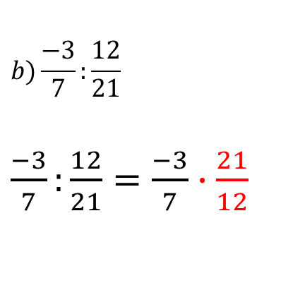





Zadatak: Izračunaj:
$$a)\frac{−4}{3}:\frac{1}{2}$$
$\frac{−4}{3}:\frac{1}{2}=$
$$\frac{−4}{3}∙\frac{2}{1}=$$
$$\frac{−8}{3}=−2\frac{2}{3}$$
$$b)\frac{−3}{7}:\frac{12}{21}$$
$\frac{−3}{7}:\frac{12}{21}=\frac{−3}{7}∙\frac{21}{12}$
$$=\frac{{−3 }^{−1}}{{7 }^{1}}∙\frac{{21 }^{3}}{{12}^{ 4}}$$
$$=\frac{−1}{1}∙\frac{3}{4}$$
$$=\frac{−3}{4}$$

Slide 13





Zadatak: Izračunaj:
$c) \frac{−4}{3}:2\frac{1}{6}$
$\frac{−4}{3}:2\frac{1}{6}=\frac{−4}{3}:\frac{13}{6}$ =
$\frac{−4}{3}∙\frac{6}{13}=$
$\frac{−4}{3^{1}}∙\frac{6^{2}}{13}=$
$\frac{−4}{1}∙\frac{2}{13}=$
$\frac{−8}{13}$

Slide 14

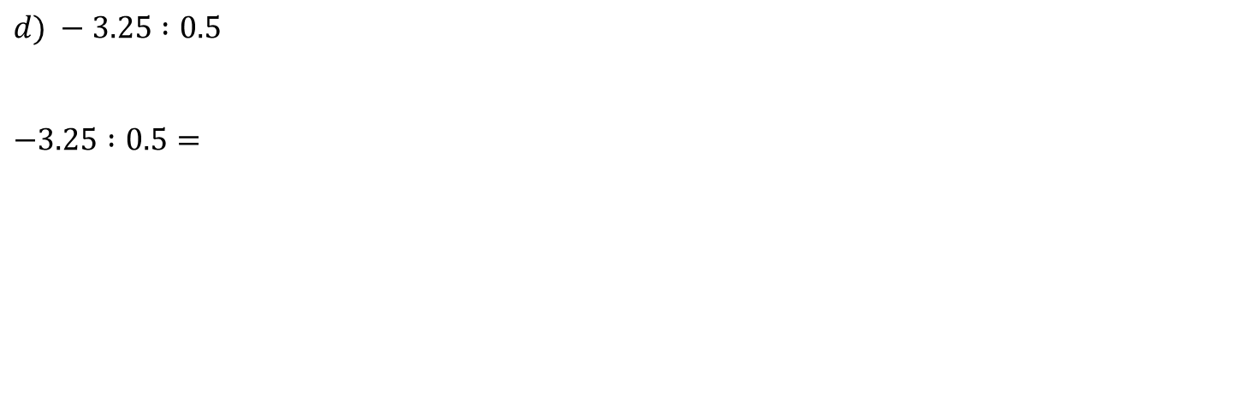



$d) −3.25 :0.5$
$−3.25 :0.5=$
${−3.25}^{∙10}:{0.5}^{∙10}$=
$−32.5 :5$ =
$−6.5$
$$32.5:5=6.5$$
25
0

Slide 15





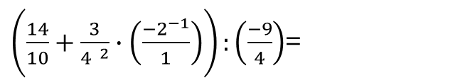

e)$\left(1.4+\frac{3}{4}∙\left(−2\right)\right):\left(−2\frac{1}{4}\right)$
$\left(1.4+\frac{3}{4}∙\left(−2\right)\right):\left(−2\frac{1}{4}\right)=\left(\frac{14}{10}+\frac{3}{4}∙\left(\frac{−2}{1}\right)\right):\left(\frac{−9}{4}\right)=$
$\left(\frac{14}{10}+\frac{3}{2}∙\left(\frac{−1}{1}\right)\right):\left(\frac{−9}{4}\right)$=
$\frac{−1}{10}:$ $\left(\frac{−9}{4}\right)$= $\frac{−1}{10}∙$ $\left(\frac{−4}{9}\right)$ =
$\left(\frac{14}{10}+\frac{3}{4^{ 2}}∙\left(\frac{{−2}^{−1}}{1}\right)\right):\left(\frac{−9}{4}\right)$=
$\left(\frac{14}{10}−\frac{3}{2}\right):\left(\frac{−9}{4}\right)$=
$\left(\frac{14}{10}−\frac{15}{10}\right):\left(\frac{−9}{4}\right)=$
$\frac{−1}{{10}^{5}}∙$ $\left(\frac{{−4}^{−2}}{9}\right)$=
$\frac{−1}{5}∙$ $\left(\frac{−2}{9}\right)$=
$\frac{2}{45}$

Slide 16
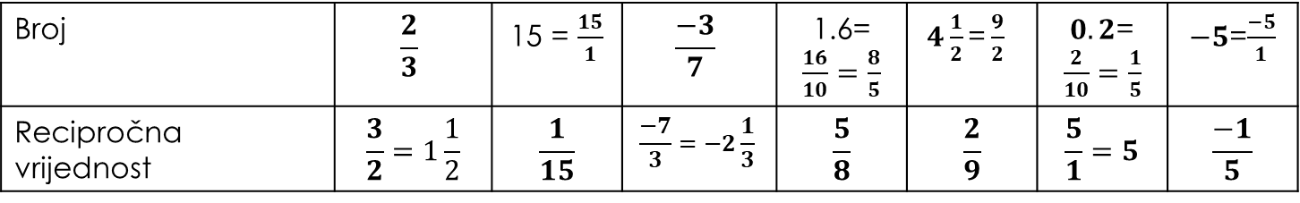
Plan ploče
Dijeljenje racionalnih brojeva
Popuni tablicu.
Racionalne brojeve dijelimo tako da djeljenik
pomnožimo recipročnom vrijednošću djelitelja.
Broj | $$\frac{2}{3}$$ | 15 = $\frac{15}{1}$ | $$\frac{−3}{7}$$ | 1.6=$\frac{16}{10}=\frac{8}{5}$ | $4\frac{1}{2}\text{=}\frac{9}{2}$ | $0.2$=$\frac{2}{10}=\frac{1}{5}$ | $−5$=$\frac{−5}{1}$
Recipročna vrijednost | $$\frac{3}{2}=1\frac{1}{2}$$ | $$\frac{1}{15}$$ | $$\frac{−7}{3}=−2\frac{1}{3}$$ | $$\frac{5}{8}$$ | $$\frac{2}{9}$$ | $$\frac{5}{1}=5$$ | $$\frac{−1}{5}$$
+ : + = +
– : – = +
+ : – = –
– : + = –

Slide 17

Plan ploče
Dijeljenje racionalnih brojeva
Zadatak: Izračunaj:
$$a)\frac{−4}{3}:\frac{1}{2}$$
$\frac{−4}{3}:\frac{1}{2}=\frac{−4}{3}∙\frac{2}{1}=\frac{−8}{3}=−2\frac{2}{3}$
$$b)\frac{−3}{7}:\frac{12}{21}$$
$\frac{−3}{7}:\frac{12}{21}=\frac{{−3}^{ −1}}{7^{ 1}}∙\frac{{21}^{ 3}}{{12}^{ 4}}=\frac{−1}{1}∙\frac{3}{4}=\frac{−3}{4}$

Slide 18
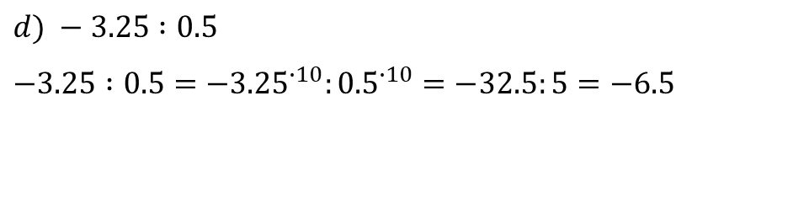


Plan ploče
Dijeljenje racionalnih brojeva
Zadatak: Izračunaj:
$c) \frac{−4}{3}:2\frac{1}{6}$
$$\frac{−4}{3}:2\frac{1}{6}=\frac{−4}{3}:\frac{13}{6}=\frac{−4}{3^{ 1}}∙\frac{6^{ 2}}{13}=\frac{−4}{1}∙\frac{2}{13}=\frac{−8}{13}$$
$d) −3.25 :0.5$
${−3.25 :0.5=−3.25}^{∙10}:{0.5}^{∙10}=−32.5:5=−6.5$
$$32.5:5=6.5$$
25
0

Slide 19

Plan ploče
$e) \left(1.4+\frac{3}{4}∙\left(−2\right)\right):\left(−2\frac{1}{4}\right)$
$$\left(1.4+\frac{3}{4}∙\left(−2\right)\right):\left(−2\frac{1}{4}\right)=\left(\frac{14}{10}+\frac{3}{4^{2}}∙\left(\frac{{−2}^{−1}}{1}\right)\right):\left(\frac{−9}{4}\right)=\left(\frac{14}{10}+\frac{3}{2}∙\left(\frac{−1}{1}\right)\right):\left(\frac{−9}{4}\right)\text{=} \\ \left(\frac{14}{10}−\frac{3}{2}\right):\left(\frac{−9}{4}\right)=\left(\frac{14}{10}−\frac{3}{2}\right):\left(\frac{−9}{4}\right)\text{=}\left(\frac{14}{10}−\frac{15}{10}\right):\left(\frac{−9}{4}\right)=\frac{−1}{10}: \left(\frac{−9}{4}\right)\text{=} \\ \frac{−1}{{10}^{5}}∙ \left(\frac{{−4}^{−2}}{9}\right)\text{=}\frac{−1}{5}∙ \left(\frac{−2}{9}\right)\text{=}\frac{2}{45}$$
Dijeljenje racionalnih brojeva

Slide 20

Plan ploče
Dijeljenje racionalnih brojeva
1. Izračunaj:
$4 :\left(−\frac{3}{2}\right)$
$\frac{−12}{39} :6$
$4\frac{1}{6} :\left(−2\frac{1}{2}\right)$
$25.84 :0.4$
$−42.64 :0.004$
$\frac{1}{2}:\frac{5}{8}−0.2∙\frac{1}{2}+\frac{3}{4}:1\frac{1}{4}$
$\left(\frac{1}{2}−\frac{3}{4}:\frac{9}{20}\right)−0.5+\left(0.75:\frac{3}{4}+\frac{1}{2}\right)$
2. Razlici brojeva $\frac{7}{6}$ i $\frac{−2}{3}$ dodaj njihov količnik.

Slide 21

Plan ploče
Dijeljenje racionalnih brojeva
1. Izračunaj:
$4:\left(−\frac{3}{2}\right)=\frac{4}{1}:\left(−\frac{3}{2}\right)=\frac{4}{1}∙\left(\frac{−2}{3}\right)=\frac{−8}{3}=−2\frac{2}{3}$
$\frac{−12}{39}:6=\frac{−12}{39}:\frac{6}{1}=\frac{{−12}^{ −2}}{39}∙\frac{1}{6^{ 1}}=\frac{−2}{39}∙\frac{1}{1}=\frac{−2}{39}$
$4\frac{1}{6}:\left(−2\frac{1}{2}\right)=\frac{25}{6}:\left(\frac{−5}{2}\right)=\frac{{25}^{ 5}}{6^{ 3}}∙\left(\frac{{−2}^{ −1}}{5^{ 1}}\right)=\frac{5}{3}∙\left(\frac{−1}{1}\right)=\frac{−5}{3}=−1\frac{2}{3}$
$25.84 :0.4={25.84}^{∙10}:{0.4}^{∙10}=258.4 :4=64.6$
$−42.64:0.004={−42.64}^{∙1000}:{0.004}^{∙1000}=−42640:4=−10660$
$\frac{1}{2}:\frac{5}{8}−0.2∙\frac{1}{2}+\frac{3}{4}:1\frac{1}{4}=\frac{1}{2}∙\frac{8}{5}−\frac{1}{5}∙\frac{1}{2}+\frac{3}{4}:\frac{5}{4}=\frac{1}{2^{ 1}}∙\frac{4^{ 2}}{5}−\frac{1}{5}∙\frac{1}{2}+\frac{3}{4^{ 1}}∙\frac{4^{ 1}}{5}=\frac{1}{1}∙\frac{4}{5}−\frac{1}{10}+\frac{3}{1}∙\frac{1}{5}=\frac{4}{5}−\frac{1}{10}+\frac{3}{5}=$
$\frac{8}{10}−\frac{1}{10}+\frac{6}{10}=\frac{−1}{10}+\frac{14}{10}=\frac{13}{10}=1\frac{3}{10}$

Slide 22

Plan ploče
Dijeljenje racionalnih brojeva
1. Izračunaj:
$\left(\frac{1}{2}−\frac{3}{4}:\frac{9}{20}\right)−0.5+\left(0.75:\frac{3}{4}+\frac{1}{2}\right)=\left(\frac{1}{2}−\frac{3}{4}:\frac{9}{20}\right)−\frac{1}{2}+\left(\frac{3}{4}:\frac{3}{4}+\frac{1}{2}\right)=\left(\frac{1}{2}−\frac{3^{ 1}}{4^{ 1}}∙\frac{{20}^{ 5}}{9^{ 3}}\right)−\frac{1}{2}+\left(\frac{3^{ 1}}{4^{ 1}}∙\frac{4^{ 1}}{3^{ 1}}+\frac{1}{2}\right)$
$=\left(\frac{1}{2}−\frac{1}{1}∙\frac{5}{3}\right)−\frac{1}{2}+\left(\frac{1}{1}∙\frac{1}{1}+\frac{1}{2}\right)=\left(\frac{1}{2}−\frac{5}{3}\right)−\frac{1}{2}+\left(\frac{1}{1}+\frac{1}{2}\right)=\left(\frac{3}{6}−\frac{10}{6}\right)−\frac{1}{2}+\left(\frac{2}{2}+\frac{1}{2}\right)=$ $\frac{−7}{6}−\frac{1}{2}+\frac{3}{2}=$
$\frac{−7}{6}−\frac{3}{6}+\frac{9}{6}=\frac{−10}{6}+\frac{9}{6}=\frac{−1}{6}$
2. Razlici brojeva $\frac{7}{6}$ i $\frac{−2}{3}$ dodaj njihov količnik.
$\left(\frac{7}{6}−\left(\frac{−2}{3}\right)\right)+$ $\left(\frac{7}{6}:\left(\frac{−2}{3}\right)\right)=\left(\frac{7}{6}+\frac{2}{3}\right)+\left(\frac{7}{6^{ 2}}∙\left(\frac{{−3}^{ −1}}{2}\right)\right)=\left(\frac{7}{6}+\frac{4}{6}\right)+\left(\frac{7}{2}∙\left(\frac{−1}{2}\right)\right)=\frac{11}{6}+\left(\frac{−7}{4}\right)=\frac{11}{6}−\frac{7}{4}=\frac{22}{12}−\frac{21}{12}=\frac{1}{12}$

