Slide 1
The games of our grandparents
Learning scenario

Slide 2
Introduction
This learning scenario is a result of the Europeana project
The aim of this scenario was to show our students that playing is an essential part of their childhood
The task is to motivate children for playing games which were played by their parents and grandparents
Just follow the steps and have a great time with your students!

Slide 3
Step 1
Guess the topic: wordwall
Use mentimeter to learn more about students’ free time activities

Slide 4
Step 2
After guessing the topic, the teacher introduces Europeana and explains the students how they can successfully do the research and find the necessary data.

Slide 5
Step 3
Students make up groups and start searching Europeana – the topic is „children’s game)
They are supposed to choose one photo and describe what children are doing in the photo.
The results will be shown in Padlet.

Slide 6
Step 4
Students are watching three videoes fromEuropeana (Children's party on the ice rank, Children's games, Marble sports reign supreme)
Discussion – we talk about past and present way of life and what children were / are doing in their free time

Slide 7
Step 5
Project – students should talk to their parents and grandparents and find out more about games they played when they were children – they will write the results into the table (on the next slide).

Slide 8
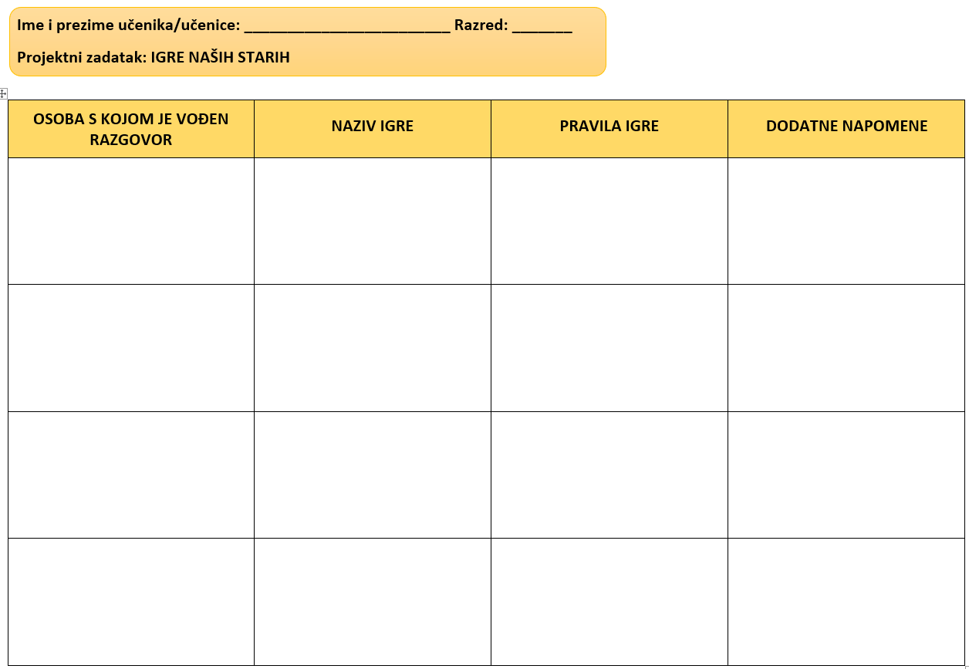

Slide 9
Step 6
The next lesson is held in the IT classroom – using Popplet students will present one of the games (it is important that each student presents another game)

Slide 10
Step 7
Next lesson students will go outside and play games that they described in Popplet.

Slide 11
Evaluation
The last activity is evaluation – students will fill out the Google Forms.

