Slide 1
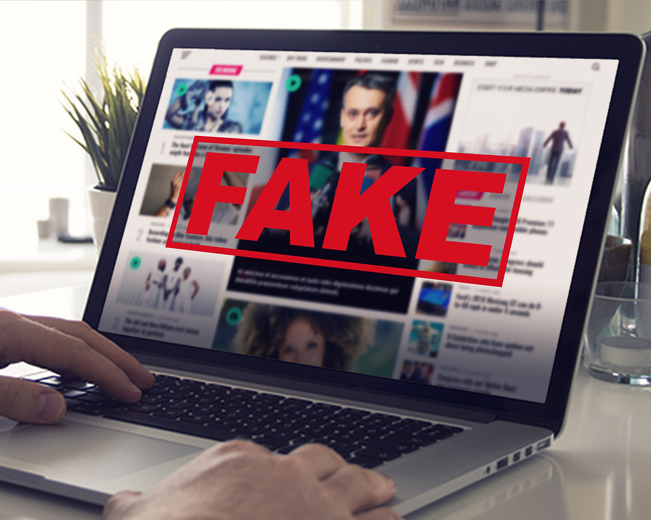
Fake news: Can you spot it?

Slide 2
Task 1. Discussion
Where do you get your news? Which sources do you use?
What do you think about this sentence? ‘It must be true because I read it on the internet.’
What do you understand by ‘fake news’? Brainstorm some keywords you associate with it.

Slide 3
Definition of fake news:
False stories that appear to be news, spread on the internet or using other media, usually created to influence political views or as a joke.
Cambridge dictionary

Slide 4
Definition of fake news:
The deliberate spreading of misinformation or hoaxes spread via traditional print and broadcast news media or online media. Fake news is written and published usually with the intent to mislead in order to damage an agency, entity or person, and/or gain financially or politically, often using sensationalist, dishonest or outright fabricated headlines and images to increase readership.
Wikipedia

Slide 5
Task 3: Two websites
 | Habitat | Characteristics | History
Tree Octopus
Octopus Tree

Slide 6
Task 3: Key
 | Habitat | Characteristics | History
Tree Octopus | In the temperate rainforests of the west coast of North America. | The octopus has eight arms. On average (measured from arm-tip to mantle-tip) it is 30–33cm long. It is amphibious, intelligent and its eyesight is comparable to that of humans. | The octopus has become endangered because the fashion industry began to kill it in large numbers and sell it to the rich in the form of hat ornaments.
Octopus Tree | Pacific Northwest coast of the USA | The tree itself extends from a central base that is 15 metres around, and instead of shooting straight up with a central trunk, the body of the tree splits into a number of smaller trunks. | It is believed to be around 250 to 300 years old. No one knows how this tree came to have so many trunks.
https://www.teachingenglish.org.uk/

Slide 7
Task 4: The 5 Questions
WHERE does the information come from? Look at the URL. Does it look familiar or credible?
WHEN was the post put online? What’s the date on the post? Is the date real? Is the post recent?
WHO created the information? Who wrote the article? Who took the photo?
WHAT does the post or website look like? Look at the layout. Is the website well presented and carefully organised?
HOW do you know for certain that it’s true? Does any information seem unlikely, or too good to be true?

